Slide 1
Hosanna

Slide 2
Verse 1
G C
Praise is rising, eyes are turning to You
G
We turn to You
G C
Hope is stirring, hearts are yearning for You
G
We long for You

Slide 3
Pre-Chorus
D
'Cause when we see You
C G
We find strength to face the day
D
And in Your presence
C G
All our fears are washed away
D
washed away

Slide 4
G Em C
Hosanna, hosanna
G D
You are the God who saves us,
Em C
worthy of all our praises
play x2

Slide 5
Verse 2
G C
Hear the sound of hearts returning to You
G
We turn to You
G C
In Your kingdom broken lives are made new
G
You make us new

Slide 6
Pre-Chorus
D
'Cause when we see You
C G
We find strength to face the day
D
And in Your presence
C G
All our fears are washed away
D
washed away

Slide 7
Chorus 1
G Em C
Hosanna, hosanna
G D
You are the God who saves us,
Em C
worthy of all our praises

Slide 8
Chorus 2
G Em C
Hosanna, hosanna
G D
Come have Your way among us
Em C
We welcome You here Lord Jesus

Slide 9
Pre-Chorus
D
'Cause when we see You
C G
We find strength to face the day
D
And in Your presence
C G
All our fears are washed away

Slide 10
Pre-Chorus
D
'Cause when we see You
C G
We find strength to face the day
D
And in Your presence
C G
All our fears are washed away
D
washed away

Slide 11
Chorus 1
G Em C
Hosanna, hosanna
G D
You are the God who saves us,
Em C
worthy of all our praises

Slide 12
Chorus 2
G Em C
Hosanna, hosanna
G D
Come have Your way among us
Em C
We welcome You here Lord Jesus
play x2 END

Slide 13
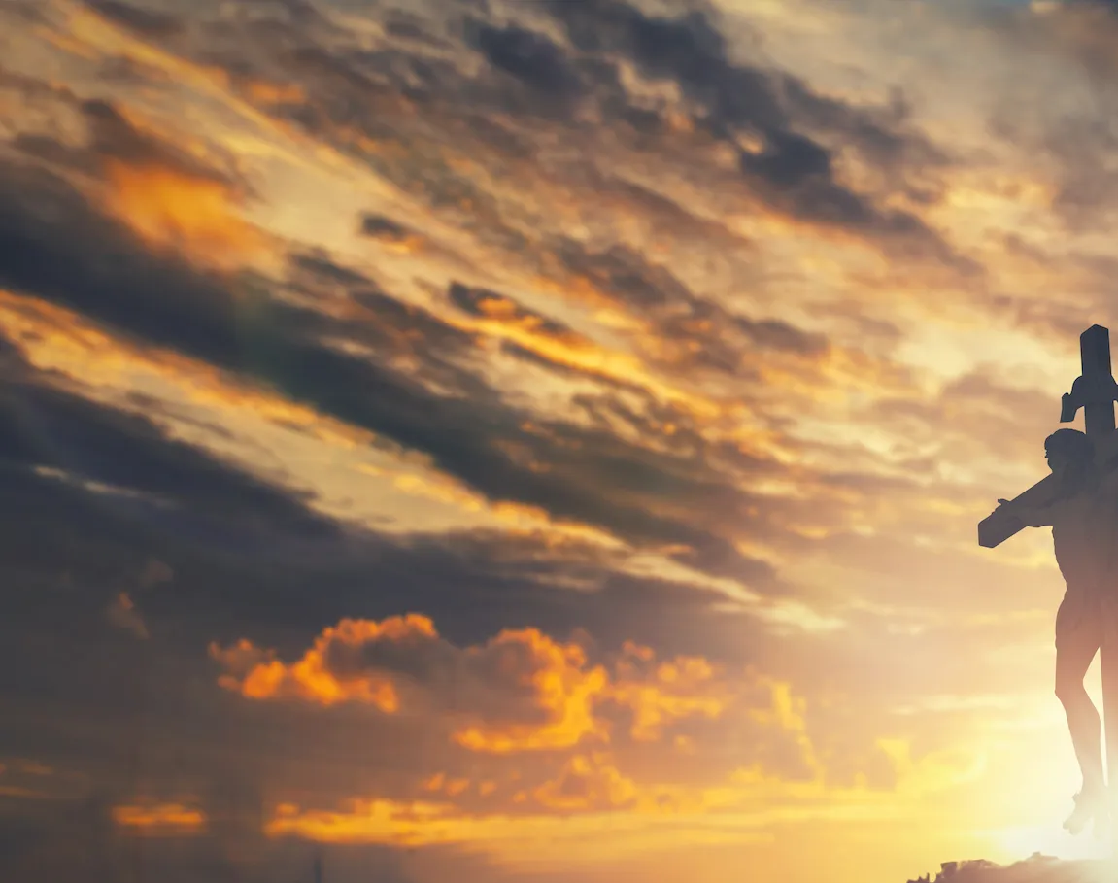
Tis So Sweet To Trust in Jesus

Slide 14
G / D / C
G C
Tis so sweet to trust in Jesus;
Em D
Just to take Him at His word,
G C
Just to rest upon His promise
Em C D G
And to know, "Thus saith the Lord."

Slide 15
G D
Jesus, Jesus, how I trust Him!
Em D
How I've proved Him o'er and o'er.
G C
Jesus, Jesus, precious Jesus,
Em C D G
O for grace to trust Him more

Slide 16
G C
O how sweet to trust in Jesus;
Em D
Just to trust His cleansing blood,
G C
And in simple faith to plunge me
Em C D G
'neath the healing, cleansing flood

Slide 17
G D
Jesus, Jesus, how I trust Him!
Em D
How I've proved Him o'er and o'er.
G C
Jesus, Jesus, precious Jesus,
Em C D G
O for grace to trust Him more

Slide 18
G C
Yes, 'tis sweet to trust in Jesus;
Em D
Just from sin and self to cease,
G C
Just from Jesus simply taking
Em C D G
Life and rest, and joy and peace.

Slide 19
G D
Jesus, Jesus, how I trust Him!
Em D
How I've proved Him o'er and o'er.
G C
Jesus, Jesus, precious Jesus,
Em C D G
O for grace to trust Him more
END

Slide 20
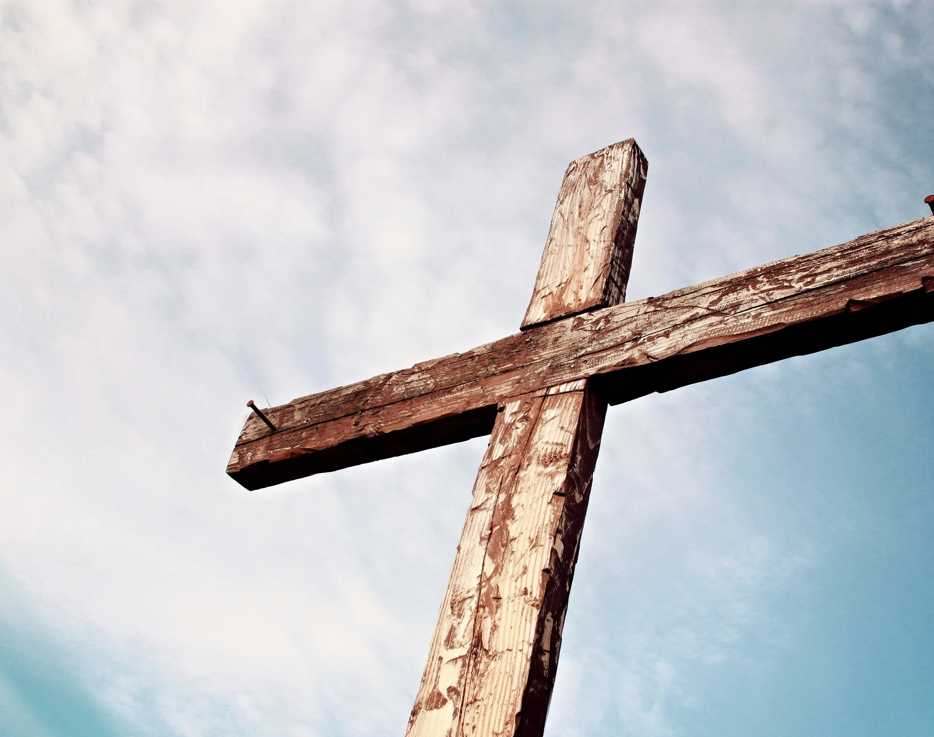
Praise To The Lord The Almighty

Slide 21
G Am Em
Praise to the Lord, the Almighty, the King of creation
G Am Em
O my soul, praise Him, for He is thy health and salvation
C D
All ye who hear, now to His temple draw near
C D G Am Em C
Praise Him in glad adoration

Slide 22
G Am Em
Praise to the Lord, Who o’er all things so wondrously reigneth
G Am Em
Shelters thee under His wings, yea, so gently sustaineth
C D
Hast thou not seen how thy desires e’er have been
C D G Am Em C
Granted in what He ordaineth?

Slide 23
G Am Em
Praise to the Lord, who doth prosper thy work and defend thee;
G Am Em
Surely His goodness and mercy here daily attend thee;
C D
Ponder anew what the Almighty can do,
C D G Am Em C
If with His love He befriend thee

Slide 24
G Am Em
Praise to the Lord, O let all that is in me adore Him
G Am Em
All that hath life and breath, come now with praises before Him
C D
Let the Amen sound from His people again
C D G Am Em C
Gladly for aye we adore Him

Slide 25
G Am Em
Praise to the Lord, the Almighty, the King of creation
G Am Em
O my soul, praise Him, for He is thy health and salvation
C D
All ye who hear, now to His temple draw near
C D G Am Em C (x2 end in G)
Praise Him in glad adoration
END

Slide 26
I Stand Amazed in the Presence

Slide 27
G
I stand amazed in the presence
D G
Of Jesus the Nazarene
C G
And wonder how He could love me,
G D G
A sinner, condemned, unclean.

Slide 28
G
How marvelous, How wonderful
D
And my song shall ever be:
G Em
How marvelous, How wonderful
Am G D G
Is my Savior's love for me

Slide 29
G
He took my sins and my sorrows;
D G
He made them His very own
C G
He bore the burden to Calvary,
G D G
And suffered and died alone

Slide 30
G
How marvelous, How wonderful
D
And my song shall ever be:
G Em
How marvelous, How wonderful
Am G D G
Is my Savior's love for me

Slide 31
G
When with the ransomed in glory,
D G
His face I at last shall see
C G
’Twill be my joy through the ages
G D G
To sing of His love for me

Slide 32
G
How marvelous, How wonderful
D
And my song shall ever be:
G Em
How marvelous, How wonderful
Am G D G
Is my Savior's love for me
END

Slide 33
Old Rugged Cross

Slide 34
G
On a hill far away
C
stood an old rugged cross,
D G
The emblem of suff’ring and shame,

Slide 35
G
And I love that old cross
C
where the Dearest and Best
D C G
For a world of lost sinners was slain.

Slide 36
D G
So I’ll cherish the old rugged cross
C G
Till my trophies at last I lay down
G C
I will cling to the old rugged cross
G D G
And exchange it some day for a crown

Slide 37
G
Oh, that old rugged cross,
C
so despised by the world
D G
Has a wondrous attraction for me

Slide 38
G
For the dear Lamb of God
C
left His glory above
D C G
To bear it to dark Calvary

Slide 39
D G
So I’ll cherish the old rugged cross
C G
Till my trophies at last I lay down
G C
I will cling to the old rugged cross
G D G
And exchange it some day for a crown

Slide 40
G
In the old rugged cross,
C
stained with blood so divine,
D G
A wondrous beauty I see;

Slide 41
G
For ’twas on that old cross
C
Jesus suffered and died,
D C G
To pardon and sanctify me

Slide 42
D G
So I’ll cherish the old rugged cross
C G
Till my trophies at last I lay down
G C
I will cling to the old rugged cross
G D G
And exchange it some day for a crown
END

